Slide 1
NOT IN MY HOTEL
"Speak out for those who cannot speak, for the rights of all the destitute." Proverbs 31:8
Notes:
“A human trafficking case is like a murder case. The victim doesn’t speak.” This quote comes from the former supervisor of all human trafficking investigations for the NYPD. Trafficking victims are often scared into silence, which means we must be a voice for the voiceless. Thank you for coming to learn about “NOT IN MY HOTEL,” an advocacy initiative aimed at educating and equipping hotels to combat child sex trafficking.

Slide 2
WHAt IS
HUMAN TRAFFICKING?
Human trafficking is the ACT of harboring, recruiting, transporting, transferring, or receiving a person by the MEANS of force, fraud, or coercion for the PURPOSE of exploitation.
Notes:
Interactive Slide- Pose these questions to your audience;
What do you think of, when you hear the phrase “Human trafficking?” What comes to mind? Tell me what you think?
After you give your audience a couple minutes to come up with their definitions explain that human trafficking can be defined as:
the ACT (of harboring, recruiting, transporting) someone by the MEANS of (force, fraud or coercion) for the PURPOSE of labor or sexual exploitation
What does this mean?
Human Trafficking, at its most basic form, is simply the buying and selling of people for the purpose of exploitation.
Traffickers use violence, threats, blackmail, false promises, deception, manipulation, and debt bondage to trap vulnerable individuals in trafficking situations.
IMPORTANT TO NOTE that a minor (anyone under 18) induced into commercial sex is a human trafficking victim – regardless if force, fraud, or coercion is present. In other words, the MEANS is not required.

Slide 3
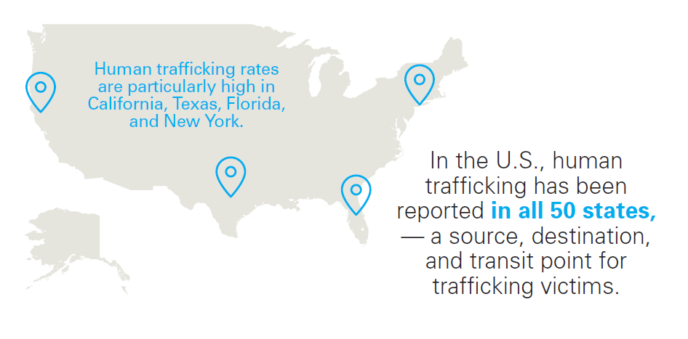
Scope of
Human Trafficking: USA
Notes:
Globally, there are around 40 million human trafficking victims worldwide.
Human trafficking is the fastest growing and 2nd most profitable criminal enterprise, right behind the illegal drug cartel.
The human trafficking industry makes $150 billion dollars a year- and 2/3 of that amount (roughly $99 billion) is from the commercial sex industry
Human trafficking occurs in EVERY SINGLE STATE
Every state in the entire country has reported human trafficking to the National Human Trafficking Hotline.
The National Human Trafficking Hotline is a national anti-trafficking hotline serving victims and survivors of human trafficking and the anti-trafficking community in the United States. Hotline Advocates offer round-the-clock access to a safe space to report tips, seek services, and ask for help. They can coordinate with local law enforcement and/or service providers.
In 2016, the hotline received a total of 30,918 substantive phone calls, emails, or online tip reports nationwide.
6,656 of theses were in connection to cases occurring in hotels and motels.
The top five states with largest call data is from: CA, TX, FL, OH and NY
Sources:
https://humantraffickinghotline.org/sites/default/files/2016%20National%20Report.pdf
https://humantraffickinghotline.org/sites/default/files/Hotel%20and%20Motel%20Topical.pdf

Slide 4
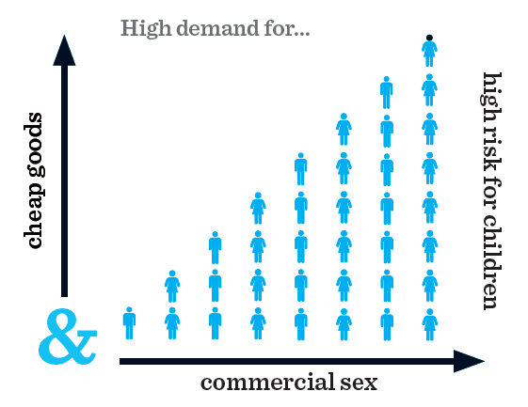
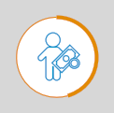
What fuels trafficking?
PROFITS ------
COSTS -----------
RISKS ---------------
1.
$$\frac{high reward}{low risk}$$
2.
Supply and Demand
3.
Systemic Inequalities
Notes:
Like drugs and arms trafficking, human trafficking is a market-driven criminal industry that is based on the principles of supply and demand. Many factors make children and adults vulnerable to human trafficking. However, human trafficking does not exist solely because many people who are vulnerable to exploitation.
Human trafficking is the only industry in which the demand and the supply are the same thing: human beings. People demanding the supply of people.
Human trafficking is lucrative ($150 dollars annually!) and widespread because it is fueled by 3 major factors:
High risk / low reward:
High Profits: When individuals are willing to buy commercial sex, they create a market and make it profitable for traffickers to sexually exploit children and adults. When consumers are willing to buy goods and services from industries that rely on forced labor, they create a profit incentive for labor traffickers to maximize revenue with minimal production costs. *High return on investment: With drugs or arms, or in most other markets, the products being sold can only be sold once. But with human trafficking, a human being can be sold over and over again. So human traffickers know there is an incredibly high return on investment: high profits, low investment cost. (ROI= (gain – cost) / cost)
Minimal risks: When the community is unaware of this issue, when government and community institutions are not trained to respond, when there are ineffective or dormant laws to address the crime, when safety nets for victims do not exist, and when law enforcement does not investigate and prosecute the crime, human traffickers perceive little risk or deterrence to affect their criminal operations.
2) Supply and Demand: Most if not all business models rely on the basic principles of supply and demand. When demand for goods increases, so must the supply. In the case of human trafficking, there is large, widespread demand for cheap goods and commercial sex. This high demand requires and sustains a high level of supply. When the “supply” in the business model of human trafficking is men, women, and children– this means that high demand puts millions of people at risk. In many cases of labor trafficking, consumers provide the demand, and thus the profit incentive, to the traffickers. Individuals who buy commercial sex acts create the demand for sex trafficking. Popular media, including certain books, movies, television shows, and music, sometimes glamorize and romanticize the commercial sex industry without properly acknowledging the presence of sex trafficking. This glamorization then fuels the demand for paying someone else to have sex with them.
3) Systemic inequalities (push and pull factors): Factors such as extreme poverty, lack of education, lack of access to health care, lack of child protection systems, systems of discrimination, conflict, and displacement make people vulnerable and more susceptible to being exploited and/or trafficked.
https://humantraffickinghotline.org/what-human-trafficking

Slide 5
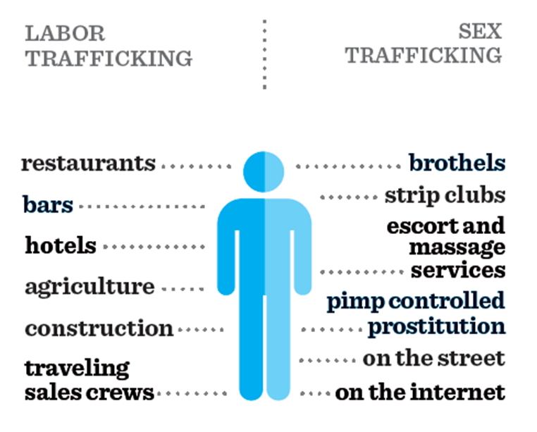
What
does it
look like?
……..hotels
Notes:
In the United States, a lot of sex trafficking victims are US citizens, while labor trafficking victims tend to be foreign nationals; most foreign nationals take what they believe to be a good, well paying job for a couple of months in the US – and many are here on legal visas too. However, when they arrive to the US they are lied to, deceived, and forced to work 14/15 hour days with the threat of deportation.
Labor trafficking may occur in any sector. There are, however, some sectors that may be more prone to trafficking:
Hospitality Service – restaurants, bars, hotels,
Agriculture
Construction
Domestic Work
Peddling/begging rings
Nail salons
Venues for Sex Trafficking
on-line/Internet, including social media
Brothels
Strip clubs
(Illicit) Massage Parlors- massage businesses that offer commercial sex either in place of or in addition to massage.
Street Prostitution- commercial sex that occurs outdoors along a strip of road referred to as a “track” or at truck stops
Once a victim is purchased for sex online or on the street, the abuse often takes place in a hotel.
There is a mistaken assumption that pimps protect women involved in prostitution. The reality is that pimps are usually traffickers.

Slide 6
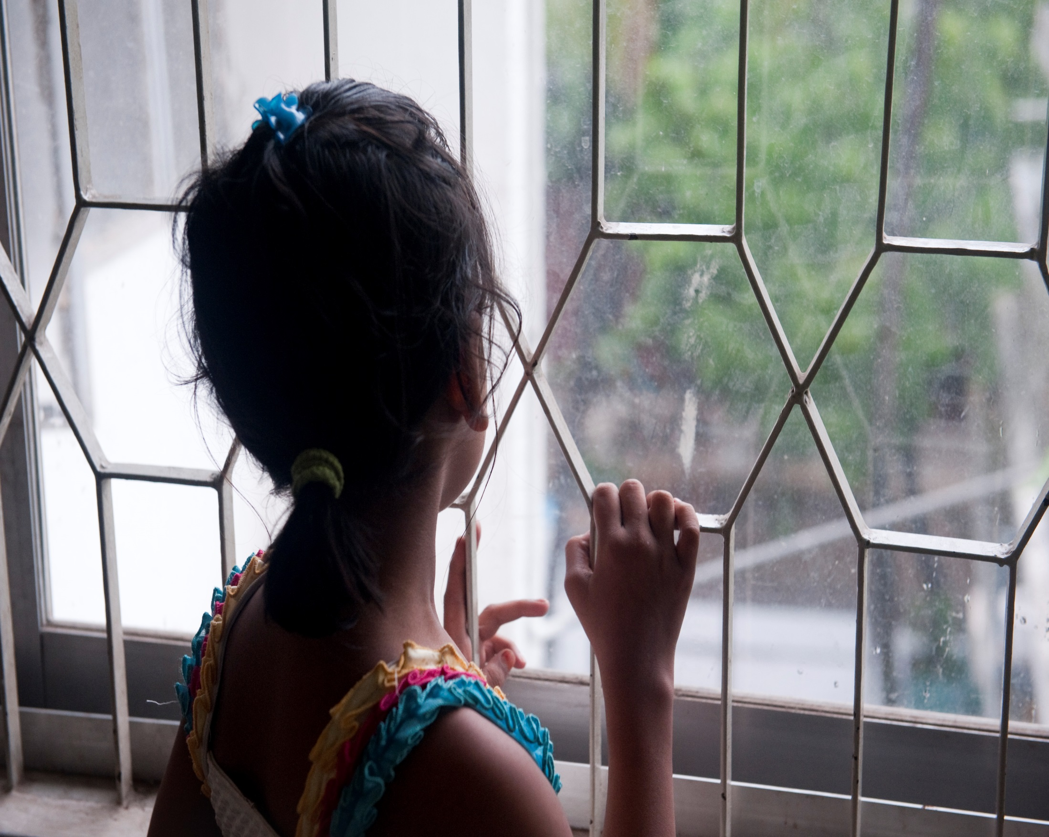
Sex trafficking in the U.S.
Notes:
Sex trafficking occurs HERE, in our country, in our state, and in our city. While labor trafficking makes up the majority of human trafficking worldwide, here in the U.S. most trafficking is sex trafficking.
And the majority of sex trafficking victims are U.S. citizens. Sex trafficking is facilitated through a wide variety of venues. But to give you a sense of a how a typical victim is exploited, I want to show you how this industry operates:

Slide 7
The “average” victim:
7
52
Days per week
Weeks per year
Buyers
per
day

Slide 8
1,820 per year
35 per week
Notes:
MO

Slide 9
The trafficker’s salary:
$200
7
52
$200
Days per week
Weeks per year
$200
$200
$200

Slide 10
$364,000 per year
Notes:
PER VICTIM.

Slide 11
Does your hotel know?
Notes:
You will need to be connected to the Internet to show the video in the slide. Click on the black square, then click on Video Tools in the tool bar, and then click on Play. You can also find the video at https://www.youtube.com/watch?v=KllVVJ4seBA.
Child sex trafficking is a problem across the United States. Children as young as 12 and 13 are integrated into the sex industry and are bought and sold alongside adults. While the hospitality industry is not responsible for the exploitation, it does have an important role to play in helping to stop it.
With the use of online classified ads, child sex trafficking is both on the streets and behind the closed doors of local hotel rooms. Pimps rent rooms in hotels, then go online to create advertisements in adult sexual services pages, and finally sell victims in hotels or have victims meet purchasers at nearby hotels. Hotel rooms are a preferred venue for the sale of children because traffickers believe they are anonymous at hotels, giving them a sense that there is little risk in their behavior.
Contrary to what many people think, child sexual exploitation takes place in hotels of all types. Most people believe that exploitation only happens in budget hotels or hotels close to an airport but luxury or branded hotels are also used by abusers. Former Subway restaurant spokesperson Jared Fogle engaged in commercial sex acts with minors in luxury hotels such as the Plaza Hotel in New York City.
Source: https://static1.squarespace.com/static/594970e91b631b3571be12e2/t/59c9b6bfb07869cc5d792b8c/1506391761747/NoVacany_Report.pdf

Slide 12
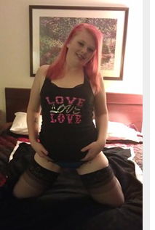
Notes:
This classified ad picturing an underage girl in a hotel room, was placed on Backpage.com, which was shut down by the US government in April 2018 for knowingly facilitating sex trafficking. However, copycat sites, such as Bedpage.com are cropping up. Social media is also a place for posting ads that sell sex with minors.

Slide 13
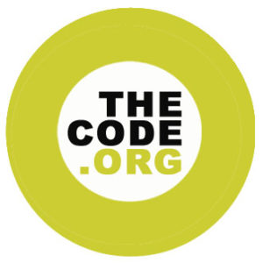
Helping hotels
help children
To establish a policy and procedures against sexual exploitation of children.
To train employees in children’s rights, the prevention of sexual exploitation and how to report suspected cases.
To include a clause in contracts throughout the value chain stating a common repudiation and zero tolerance policy of sexual exploitation of children.
To provide information to travelers on children’s rights, the prevention of sexual exploitation of children and how to report suspected cases.
To support, collaborate and engage stakeholders in the prevention of sexual exploitation of children.
To report annually on their implementation of Code related activities.
Notes:
The use of hotels in the sexual exploitation of children also means that hotels can play a key role in preventing and disrupting the commercial sexual exploitation of children. Hotel employees are more likely to witness human trafficking than the average person, and they can be trained to recognize and report suspected incidents to the appropriate authorities.
ECPAT-USA is a leader in the U.S. and around the world in working with the hospitality industry to combat child sexual exploitation. In 2004, ECPAT-USA launched the Tourism Child-Protection Code of Conduct (The Code) in North America. The Code is an internationally accepted set of guidelines with six steps that companies take to protect children from sexual exploitation. One of the six steps of The Code is to train employees. By providing awareness, tools and support to the tourism industry, The Code seeks to prevent the sexual exploitation of children.
With ECPAT-USA’s help, hotel brands implement training that they make available to the properties in their portfolios. Hotels that haven’t signed The Code can access training developed by ECPAT-USA through the American Hotel and Lodging Association.

Slide 14
Employee training - signs
TRAFFICKER
Pays in cash one day at a time
Escorts various men into the room and linger until they leave, watching the door
Requests isolated rooms, adjacent rooms, or rooms close to an exit
Removes self from operations; has adult females request rooms or pay the bills
Speaks for victim and does not leave victim alone
Controls all money and identification
Is seen with many young women who exhibit signs of trafficking
Openly threatens or physically assaults victims
Uses inappropriate nicknames with victim
Notes:
Trafficking awareness training includes educating employees on trafficking indicators. These are some examples.

Slide 15
Employee training - signs
VICTIM
Dressed inappropriately for age or weather; clothing is revealing
Fearful of authority figures, may avoid eye contact
Does not speak freely
Drugged, disoriented, confused, lacking sleep, or showing signs of abuse
Not in possession of passports, or other travel or identity documents
Has little or no luggage
Malnourished, injuries at different stages of healing, and/or lack of medical care
Refers to trafficker as “Daddy”
Keeps late or unusual hours

Slide 16
Employee training - signs
HOTEL ROOM
Excess of discarded condoms and lubricants
Room is frequented by different men
Refusal of housekeeping
Cameras and laptops
Credit card machine
Evidence of pornography
Notes:
Employee training is the mechanism for sensitizing employees to the issue of commercial sexual exploitation of children and human trafficking. Employees who are well-trained on the issue will comfortably execute their company’s protocol for responding to the issue. This prevents employees from frantically reacting to situations, which could lead to violence from an exploiter or an unnecessary scene. Rather, employees contact management, who make the decision whether to alert authorities.
Training does not always reach the front-line of hotels. Some hotel properties whose parent companies have policies and commitments to protect children are not training on the issue. This is an ongoing challenge with hotels that do not mandate but only suggest training to properties in their portfolio. With many hotel properties in the U.S. being franchised, rather than owned and operated by hotel brands themselves, training must be required at franchised properties as well. Some brands have moved towards requiring instead of suggesting training to properties and other brands must follow.
Source: https://static1.squarespace.com/static/594970e91b631b3571be12e2/t/59c9b6bfb07869cc5d792b8c/1506391761747/NoVacany_Report.pdf

Slide 17
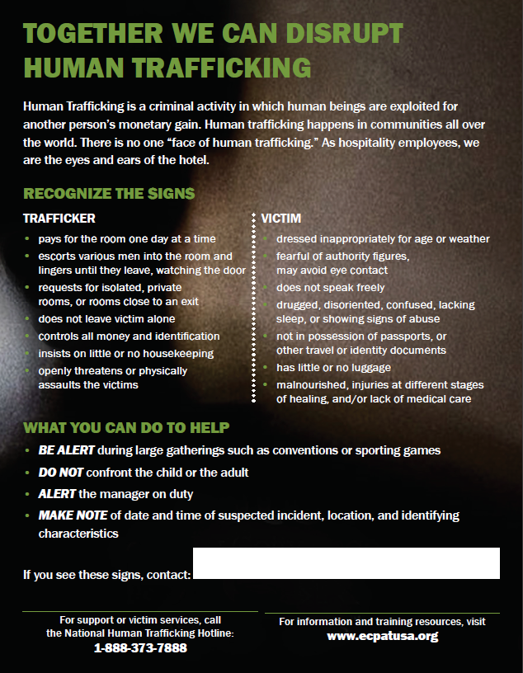
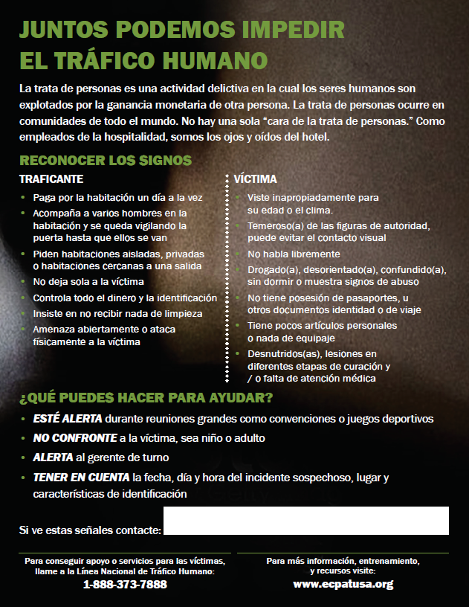
Notes:
Hotel Outreach teams will educate local hotels about the need for trafficking awareness training and provide each hotel with a folder of helpful resources in that regard. This includes a “back of the house” poster developed by ECPAT-USA in both English and Spanish. This poster lists many of the trafficking indicators we just reviewed.

Slide 18
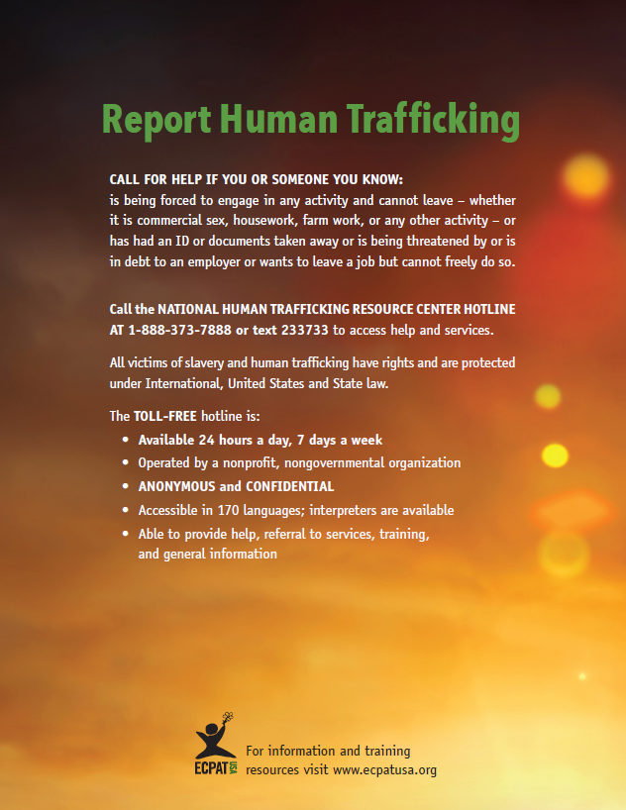
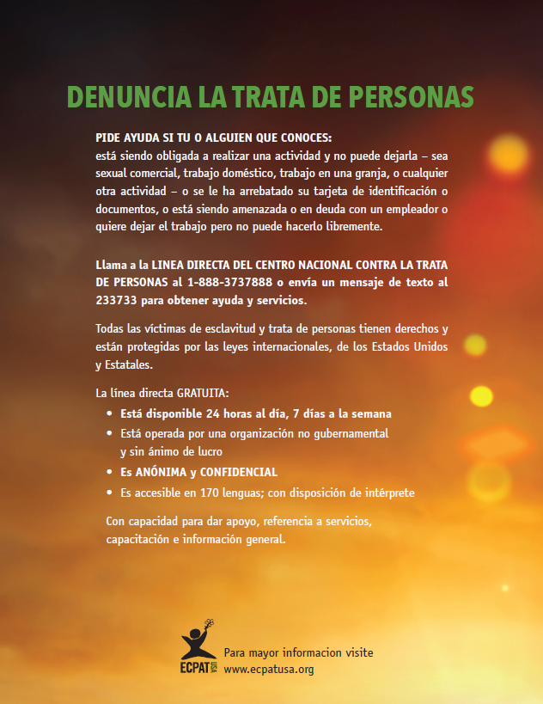
Notes:
Another resource is a “front of the house” poster developed by ECPAT-USA in both English and Spanish. Several states now require hotels to post information about trafficking, including the National Human Trafficking Hotline.
Other resources in the folder include:
Missing Children Poster, since missing and runaway youth are especially vulnerable to sex trafficking
Hotel Safety Checklist with additional measures hotels can take to protect children and youth
sheet of labels with the National Human Trafficking Hotline for housekeeping staff to stick on packages of hotel soap and place in the room of any person believed to be a potential trafficking victim

Slide 19
HOTEL
outreach
Two team members go into hotel.
Go through “hotel pitch.”
Engage them for as long as possible; see if member of management team is available. Walk through materials in the folder.
Take notes about what you experienced.
Call hotline if you see or learn of a trafficking situation.
Send follow up emails to hotel management.
Notes:
Instructions for hotel outreach teams.
The “hotel pitch” is a handout included in the toolkit.

